Slide 1
SMART CITY • IoT PROJECT
Smart House-to-House
Garbage Collection Route Optimizer
Using IoT for Smart Cities
Smart Route
Clean City
Green Future
🚛
Smart Garbage Monitoring System — Project Presentation

Slide 2
SMART GARBAGE MONITORING SYSTEM
Project Team
VA
V. Ashlin
MS
Mohit Shrivastava
RN
Rudra Narayan Rout
Reg. No. 25BCA7722
Reg. No. 25BCA7448
Reg. No. 25BCA7589
MC
Maanas C
AY
Adarsh Yadav
NC
Nukathoti Chakravarthi
Reg. No. 25BCA7302
Reg. No. 25BCA7038
Reg. No. 23BCE20107
Smart Garbage Monitoring System — Project Presentation

Slide 3
1
Problem Statement
Traditional house-to-house garbage collection follows fixed routes and schedules, regardless of whether bins are actually full or empty. This wastes fuel and municipal resources, causes traffic congestion, and leaves overflowing bins uncollected while trucks visit nearly empty ones. Without real-time monitoring, waste management stays inefficient and adds to environmental pollution.
Wasted Fuel & Cost
⛽
Trucks run full routes even when many bins are empty.
🗑
Overflowing Bins
Full bins are missed until the next scheduled visit.
📡
No Real-Time Visibility
No live data on fill levels or truck location.
The core issue: routes are static, but bin fill-levels are dynamic.
Smart Garbage Monitoring System
02

Slide 4
2
Project Aim & Proposed System
🗑
Smart Bin
This project develops an IoT-based smart house-to-house garbage collection system that monitors bin fill-levels using ultrasonic sensors. Once a bin crosses a set threshold (e.g. 80% full), the reading is pushed to a cloud database. A route-optimization algorithm then combines this data with the coordinates of each house to compute the shortest, most efficient collection path — displayed live on a web dashboard for the driver.
HC-SR04 senses fill level
📶
Arduino NodeMCU
Reads sensor, sends data
☁
Cloud Database
Stores fill-level data
🧭
Route Algorithm
Dijkstra / A* finds shortest path
Goal: cut travel distance, fuel use, and collection time — while improving overall waste-management efficiency.
Smart Garbage Monitoring System
03

Slide 5
3
Hardware Components & Budget Estimation
Estimated hardware and materials for the exhibition prototype. Prices are approximate local-market estimates and may vary by supplier and quantity.
No. | Component | Qty | Unit Price | Total
1 | Arduino NodeMCU | 1 | ₹350-450 | ₹400
2 | HC-SR04 Ultrasonic Sensor | 5 | ₹120 | ₹600
3 | Breadboard | 2 | ₹100 | ₹200
4 | Jumper Wires (Packs) | 2 | ₹125 | ₹250
5 | LEDs (Red, Yellow, Green) | 15 | ₹5 | ₹75
6 | 220Ω Resistors | 15 | ₹2 | ₹30
7 | Piezo Buzzer | 1 | ₹50 | ₹50
No. | Component | Qty | Unit Price | Total
8 | USB Cable | 1 | ₹100 | ₹100
9 | Foam Board / MDF Base | 1 | ₹300 | ₹300
10 | Mini Houses | 5 | ₹30 | ₹150
11 | Mini Garbage Bins | 5 | ₹40 | ₹200
12 | Mini Garbage Truck | 1 | ₹250 | ₹250
13 | Road Materials & Decoration | 1 | ₹150 | ₹150
14 | Glue / Tape / Misc. | 1 | ₹200 | ₹200
Estimated Total Budget
₹ 2,955
Note: 220Ω resistor total shown as ₹30, approx. ₹20 net of bulk-pack pricing.
Smart Garbage Monitoring System
04

Slide 6
—
Software Stack & Fill-Level Indicator
Software Stack (Free & Open Tools)
Bin Fill-Level Indicator (LED Thresholds)
1
Arduino IDE
Green — Low
2
Firebase
0 – 30% full
3
VS Code
Yellow — Medium
30 – 70% full
4
Leaflet / OpenStreetMap or Google Maps API
Red — High
5
HTML / CSS / JavaScript Dashboard
70 – 100% full, needs collection
6
Dijkstra / A* Route Optimization
LEDs on each smart bin unit mirror these three states, so fill status is visible at a glance in the physical model.
Smart Garbage Monitoring System
05

Slide 7
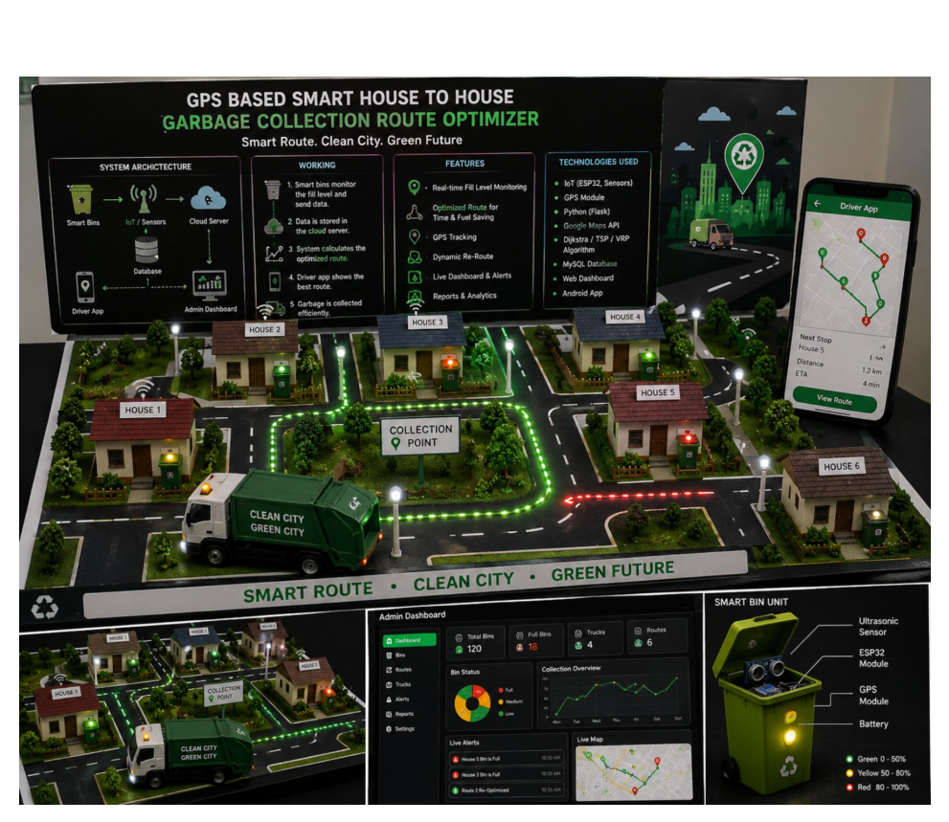
—
Prototype Model / Smart Garbage Collection System
System Architecture
Smart bins → IoT sensors → cloud server → live dashboard & driver app.
Working
Bins monitor fill level and send data; the system calculates the optimal route to follow.
Key Features
Real-time fill monitoring, dynamic re-routing, live alerts, reports & analytics.
Technologies Used
Arduino, Firebase, Dijkstra/A* routing, web dashboard.
Smart Garbage Monitoring System
08

Slide 8
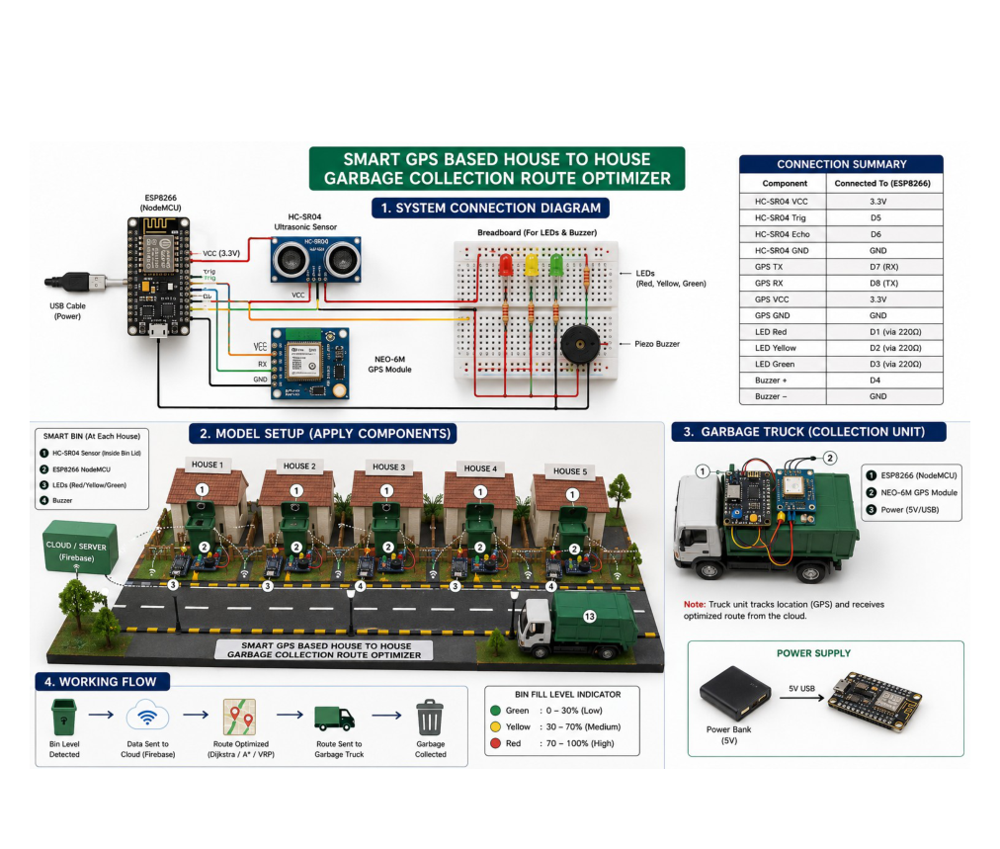
—
System Connection Diagram & Model Setup
Controller
Arduino NodeMCU is the central hub, wired to the HC-SR04 sensor.
Alerts
Breadboard carries red/yellow/green LEDs plus a piezo buzzer for local fill-level alerts.
Per-House Units
Each house repeats the same sensor-bin unit; the truck carries its own Arduino.
Power Supply
Each unit runs off a 5V USB power bank for portable, exhibition-ready operation.
Smart Garbage Monitoring System
09

Slide 9
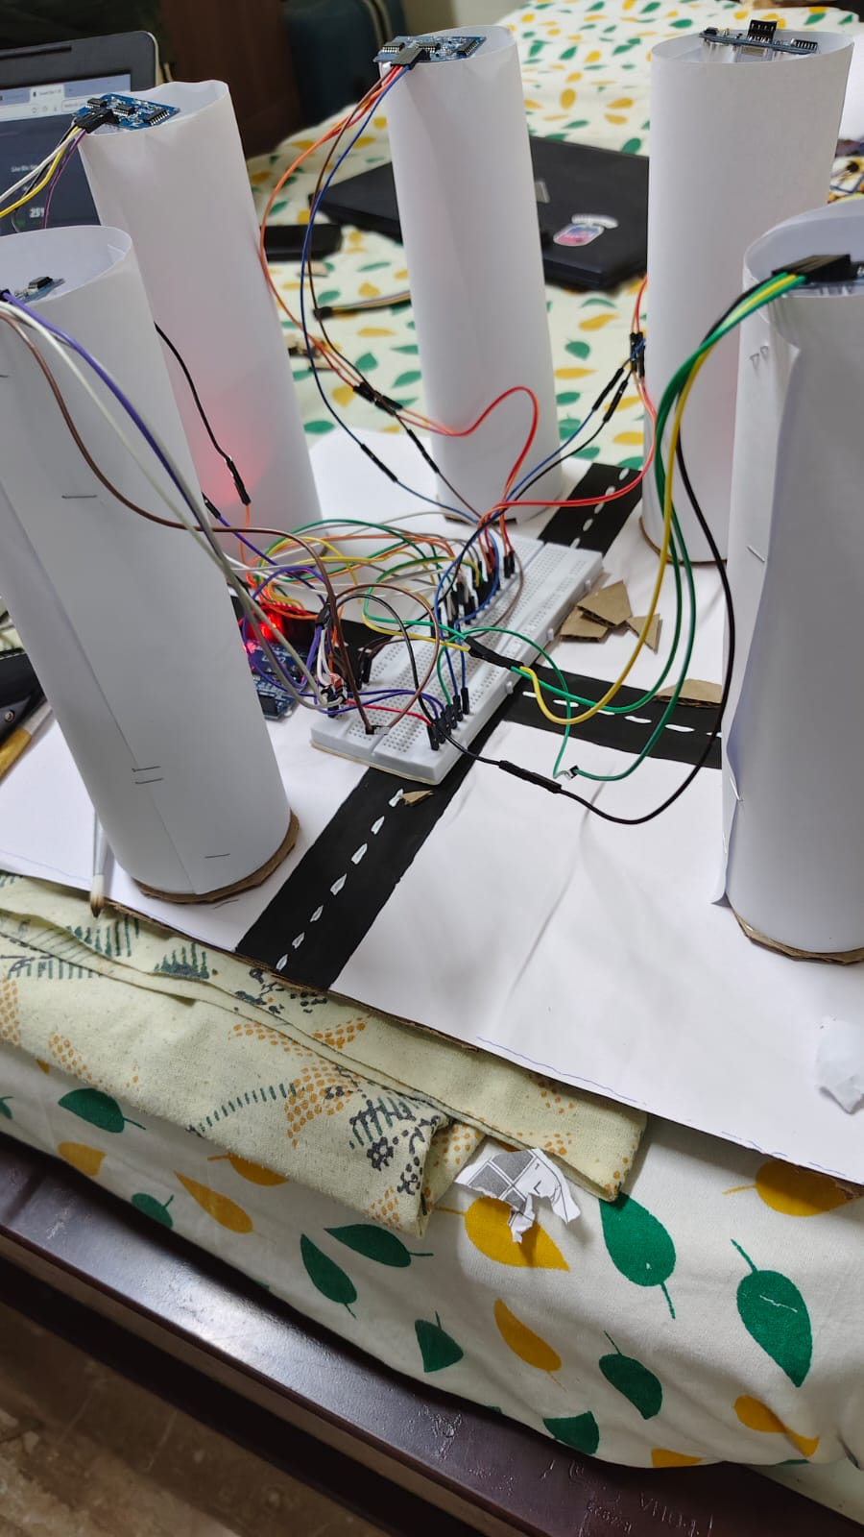
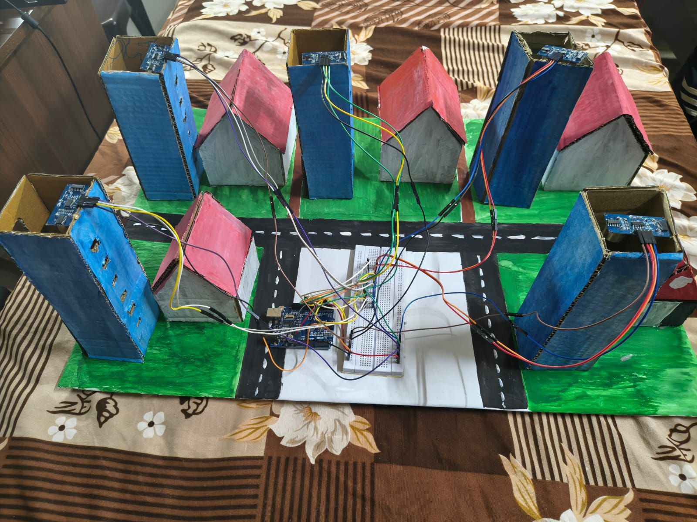
—
Working Prototype: Hardware Setup
Sensor Placement
An HC-SR04 ultrasonic sensor is mounted on top of each of the five bins.
Wiring
Sensors connect through a breadboard to the Arduino controller with jumper wires.
Town Model
Bins sit beside a painted road layout with a mini house, so the truck route is easy to show.
Wiring on breadboard
Bins, road layout and mini house
Smart Garbage Monitoring System
10

Slide 10
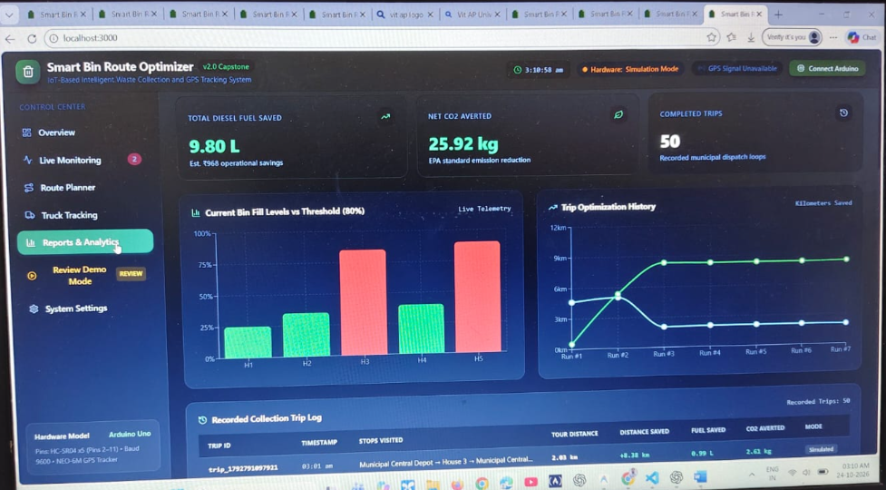
—
Dashboard: Reports & Analytics
Savings Summary
Shows 9.80 L diesel saved and 25.92 kg CO2 averted over 50 completed trips.
Fill-Level Chart
Bar chart of each bin against the 80% collection threshold.
Trip History
Line chart of kilometres saved per run, plus a log of every trip.
Smart Garbage Monitoring System
11

Slide 11
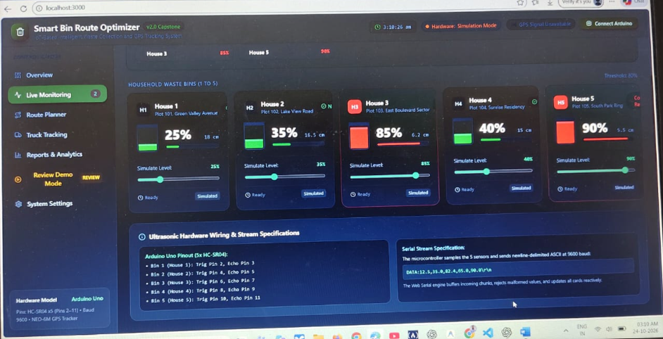
—
Dashboard: Live Bin Monitoring
Live Fill Levels
Cards for Houses 1 to 5 show fill percentage and distance to the waste.
Simulation Sliders
Each bin level can be simulated without hardware for demos.
Serial Stream
Arduino sends one line of five readings at 9600 baud to the web app.
Smart Garbage Monitoring System
12

Slide 12
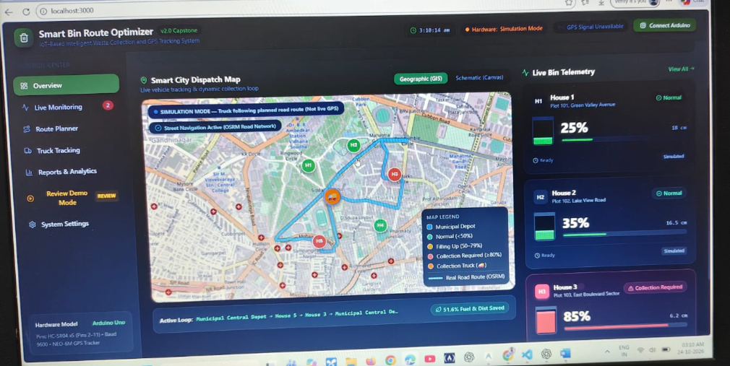
—
Dashboard: Smart City Dispatch Map
Route on Map
Truck follows a real road route from the depot to the bins that need collection.
Live Telemetry
Side panel lists each house, its fill level and status.
Savings
The active loop skips low bins and saves 51.6% fuel and distance.
Smart Garbage Monitoring System
13

Slide 13
SMART GARBAGE MONITORING SYSTEM
Thank You
Smart House-to-House Garbage Collection Route Optimizer
Smart Garbage Monitoring System

